Slide 2
Building scalable and secure applications with Azure Cosmos DB
Deborah Chen & Thomas Weiss, Program Managers

Slide 3
Agenda
Get started with new developer features
Scale your app automatically
Go to production with enterprise-grade security

Slide 4
We're building an app!
Payment processing application for the financial services industry
Expect unpredictable traffic patterns
Need to comply with strong security requirements

Slide 5
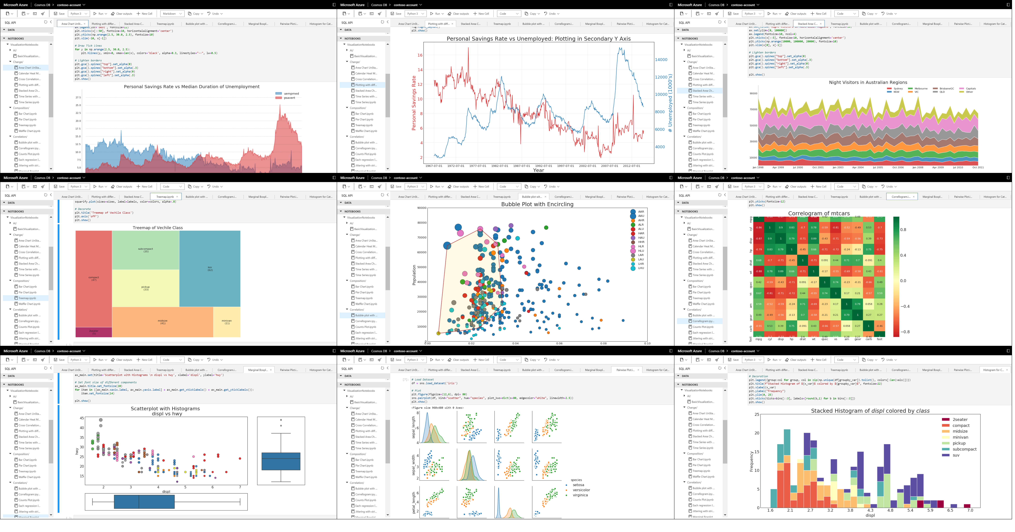
Developer Experience updates
Free tier
C# notebooks & connect notebook workspace to GitHub (preview)
New, improved Python & Java SDK (Version 4)

Slide 6
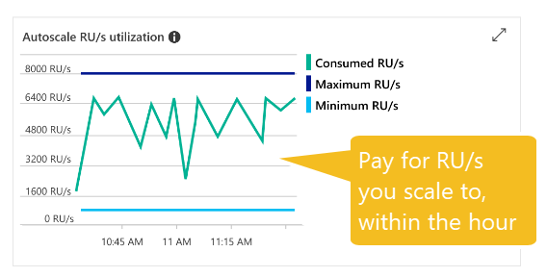
Azure Cosmos DB Autoscale (GA)
Automatically instantly scales RU/s based on usage, within 10x range
NEW: custom max RU/s & enable autoscale on existing workloads
Programmatic support now available
SDK, ARM, Portal available today
PowerShell, CLI – upcoming release
Great for variable/unpredictable
workloads
Notes:
Demo goes after here

Slide 7
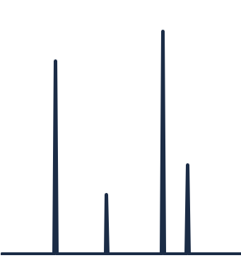
Announcing Azure Cosmos DB serverless
coming
soon
Pure consumption model: pay only for
Consumed Request Units
Consumed storage
Lowers even further Azure Cosmos DB's entry price
$
$
$
$
$
Great option for small-to-medium workloads that don't require actual throughput and receive requests sporadically

Slide 8
What we've covered so far
Better developer productivity
Better scalability
Better security!

Slide 9

Private Link for Azure Cosmos DB
Exposes your Azure Cosmos DB account to a virtual network through private endpoints
Helps reduce the risk of data exfiltration
VNET

Slide 10
Encryption at rest with customer managed keys
Provides control over the keys used to encrypt your data at rest when required for regulatory or compliance reasons
Implemented as an additional encryption layer on top of Azure Cosmos DB's default encryption at rest
Uses Azure Key Vault as key store
your data
encryption with service-managed keys
encryption with customer-managed keys

Slide 11
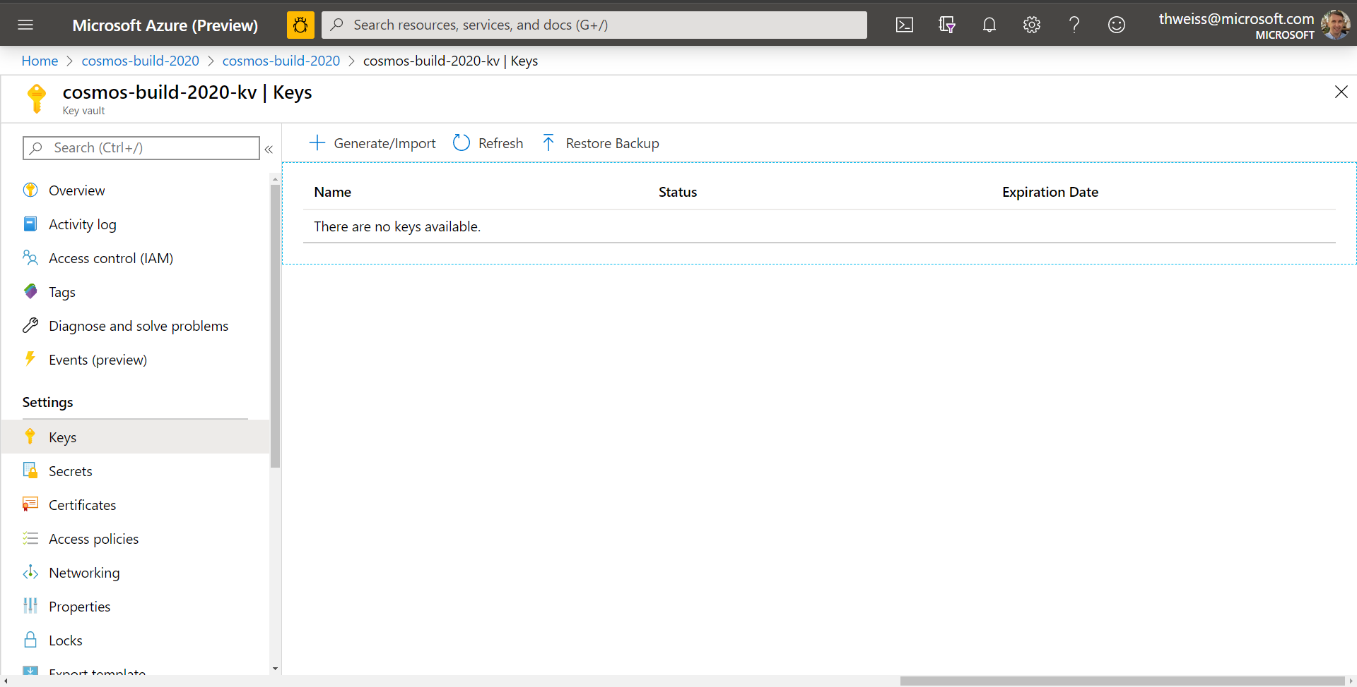

Slide 12
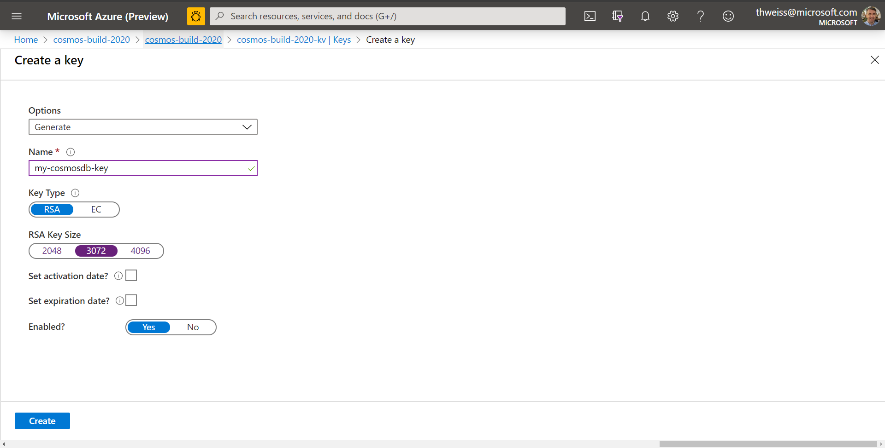

Slide 13
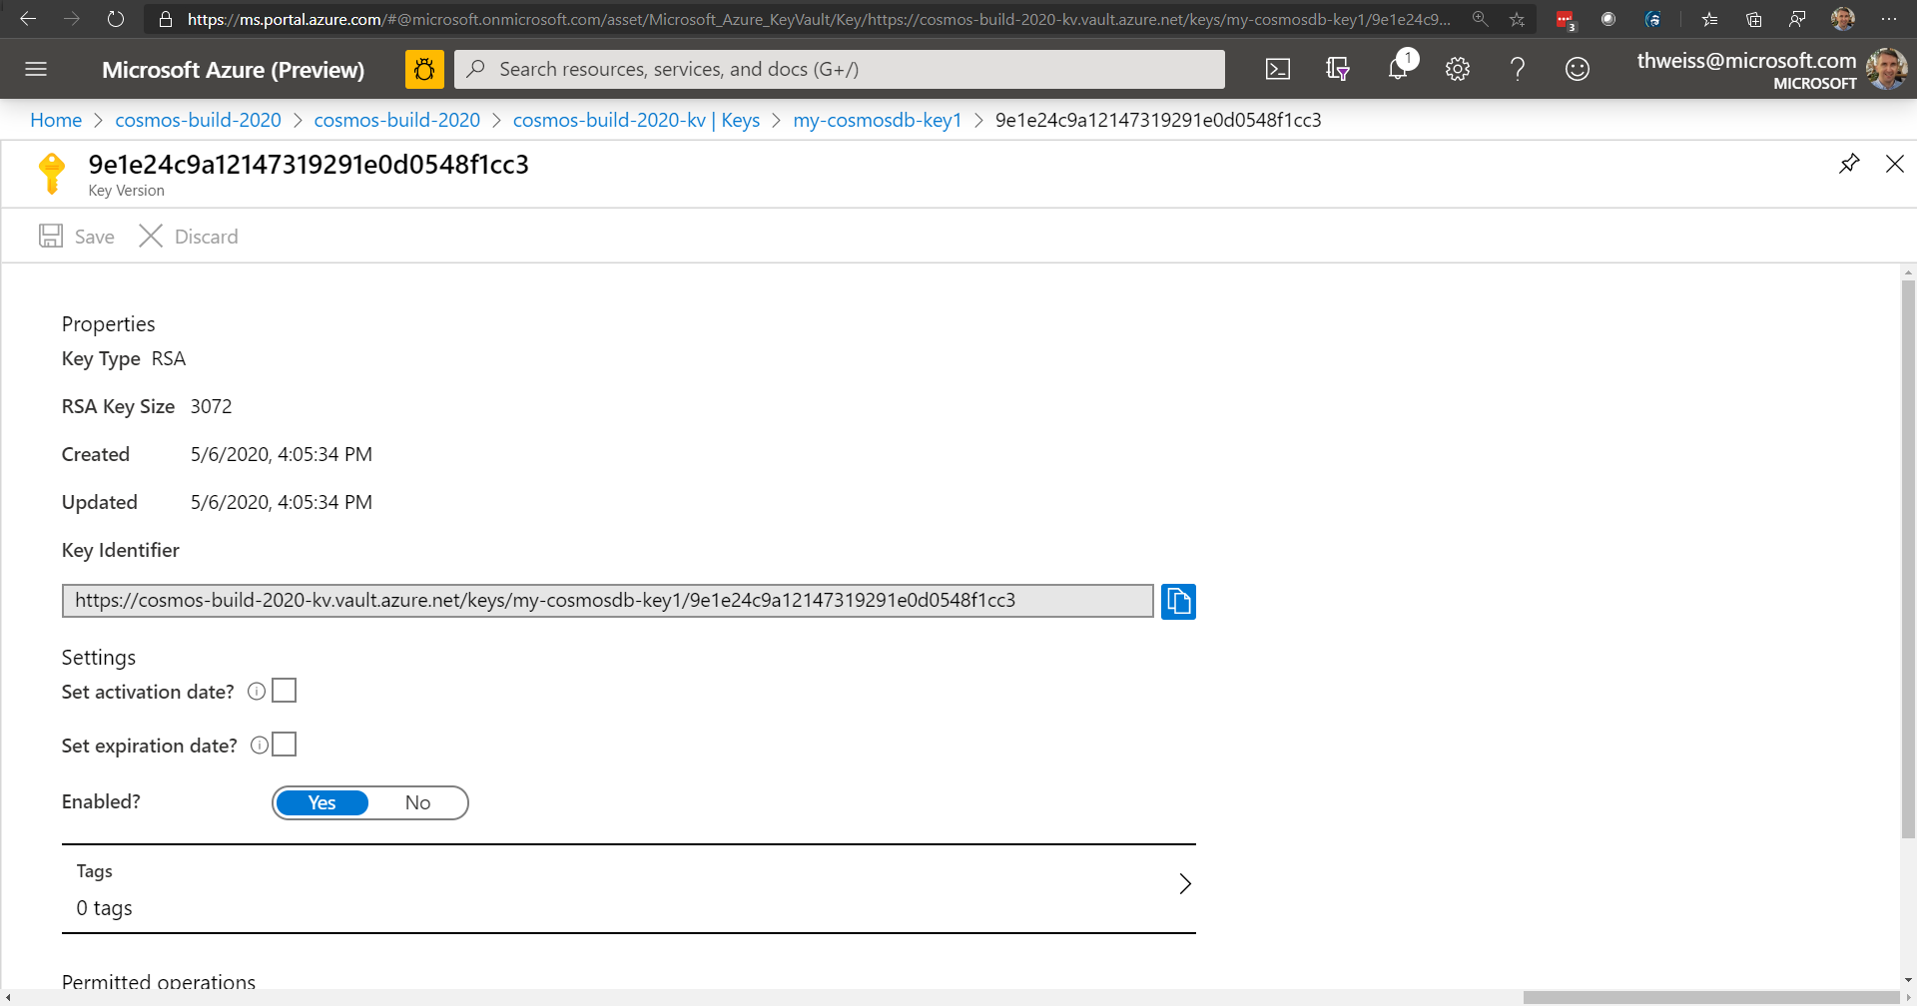

Slide 14

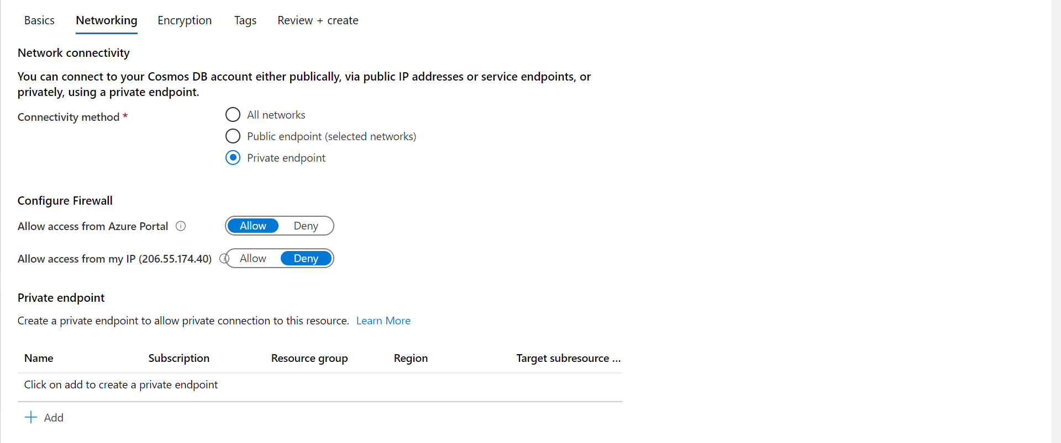


Slide 15
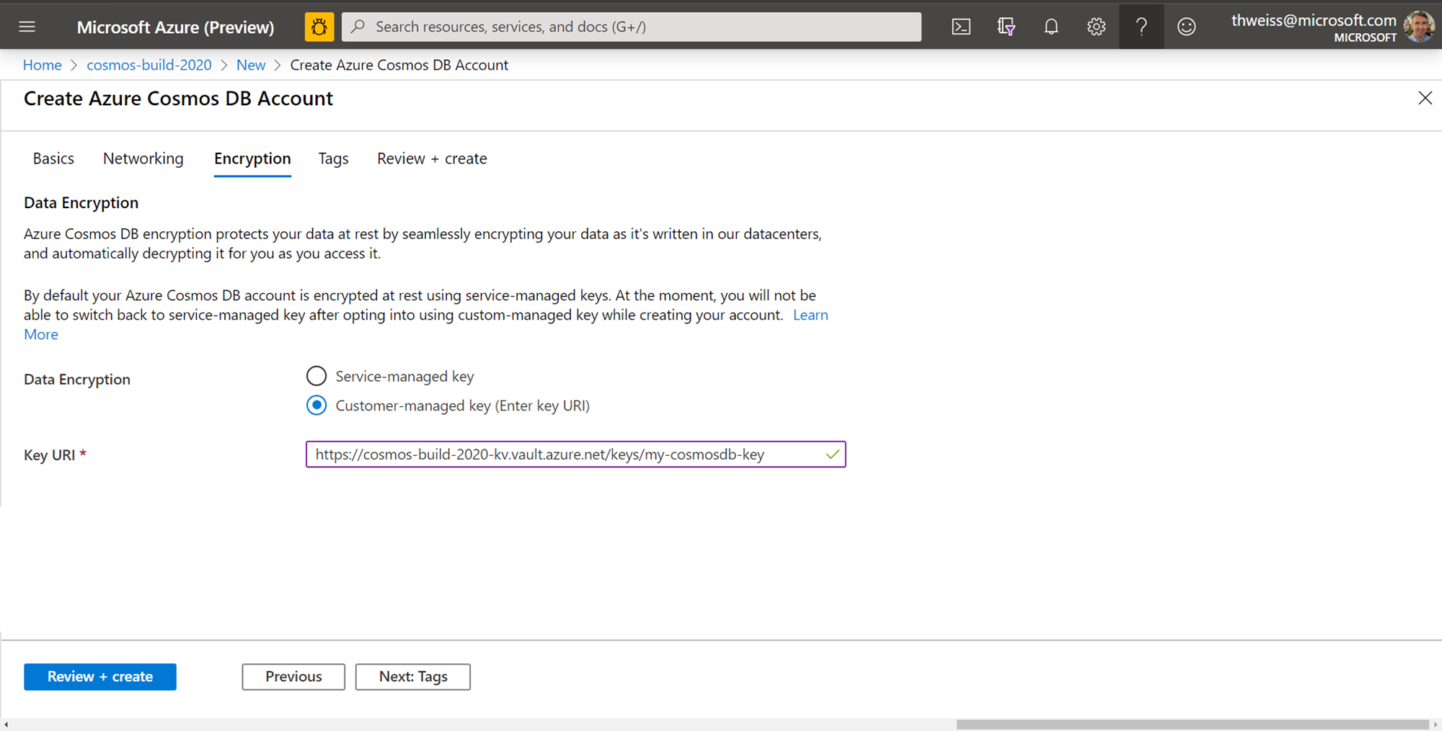

Slide 16
Wrapping up: new features you can use today!
C# Notebooks with GitHub integration
Autoscale provisioned throughput
Private Link integration
Encryption at rest with customer managed keys

Slide 17


Questions?
Additional Azure Cosmos DB session
INT 124 - Building real-time HTAP analytics solutions with Azure Cosmos DB & Azure Synapse Analytics
@AzureCosmosDB
youtube.com/azurecosmosdb

Slide 20
Certification session title here:
<link here>

